Slide 1

Exploring the potential area for a new movie theater
Vu Minh Chien
January 26,2019

Slide 2
Back ground
Business Objective: The cinema company consider to increase their business and open more movie theater in 2020
Business Question:
Which location is suitable for a new movie theater
in Ho Chi Minh city, Viet Nam ?
Stakeholder hypothesis: popular cinema location has the following criteria:
Places surrounded by shopping street, hotel, entertainment spots.
Near big road, does not locate in small roads.

Slide 3
Data
Use the list of movie theater taken from the website
Use Foursquare data to explore the surrounding area characteristics
These two dataset will be joined for further analysis

Slide 4
Methodology
Surrounding facilities will be chosen within 500 meters away from the target and limit to 20 places.
This represents the other venues around the targeted movie theater as well as the Venue Category
From the Venue category, we can understand which category should be together

Slide 5
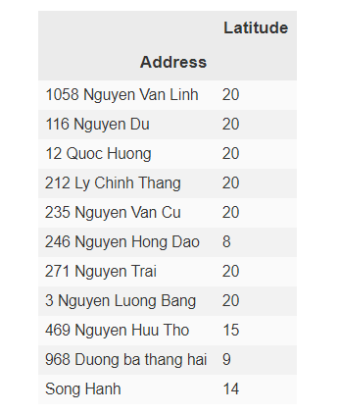
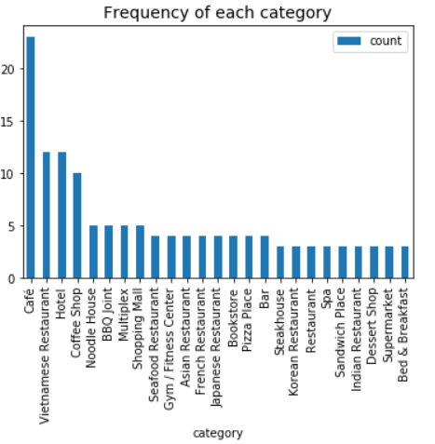
result
Half of the theaters has 20 other facilities surrounded, while there are only 3 places have under 10 venue around
Top categories are Café (23), Vietnamese restaurant (12), Hotel (12), Coffee shop (10)

Slide 6
Discussion and conclusion
The current famous movie theater are being surrounded by many venues such as restaurants, café/ coffee shop or hotel.
These movie theater are considered as healthy performance locations so somehow, we can conclude that build a new theater within the ecosystem of the other restaurants and coffee shops might be a plus for the company’s performance.
Further analysis: To further quantify the relationship of a healthy venues with its surrounding, store’s revenue data will be taken for future analysis

